Slide 1
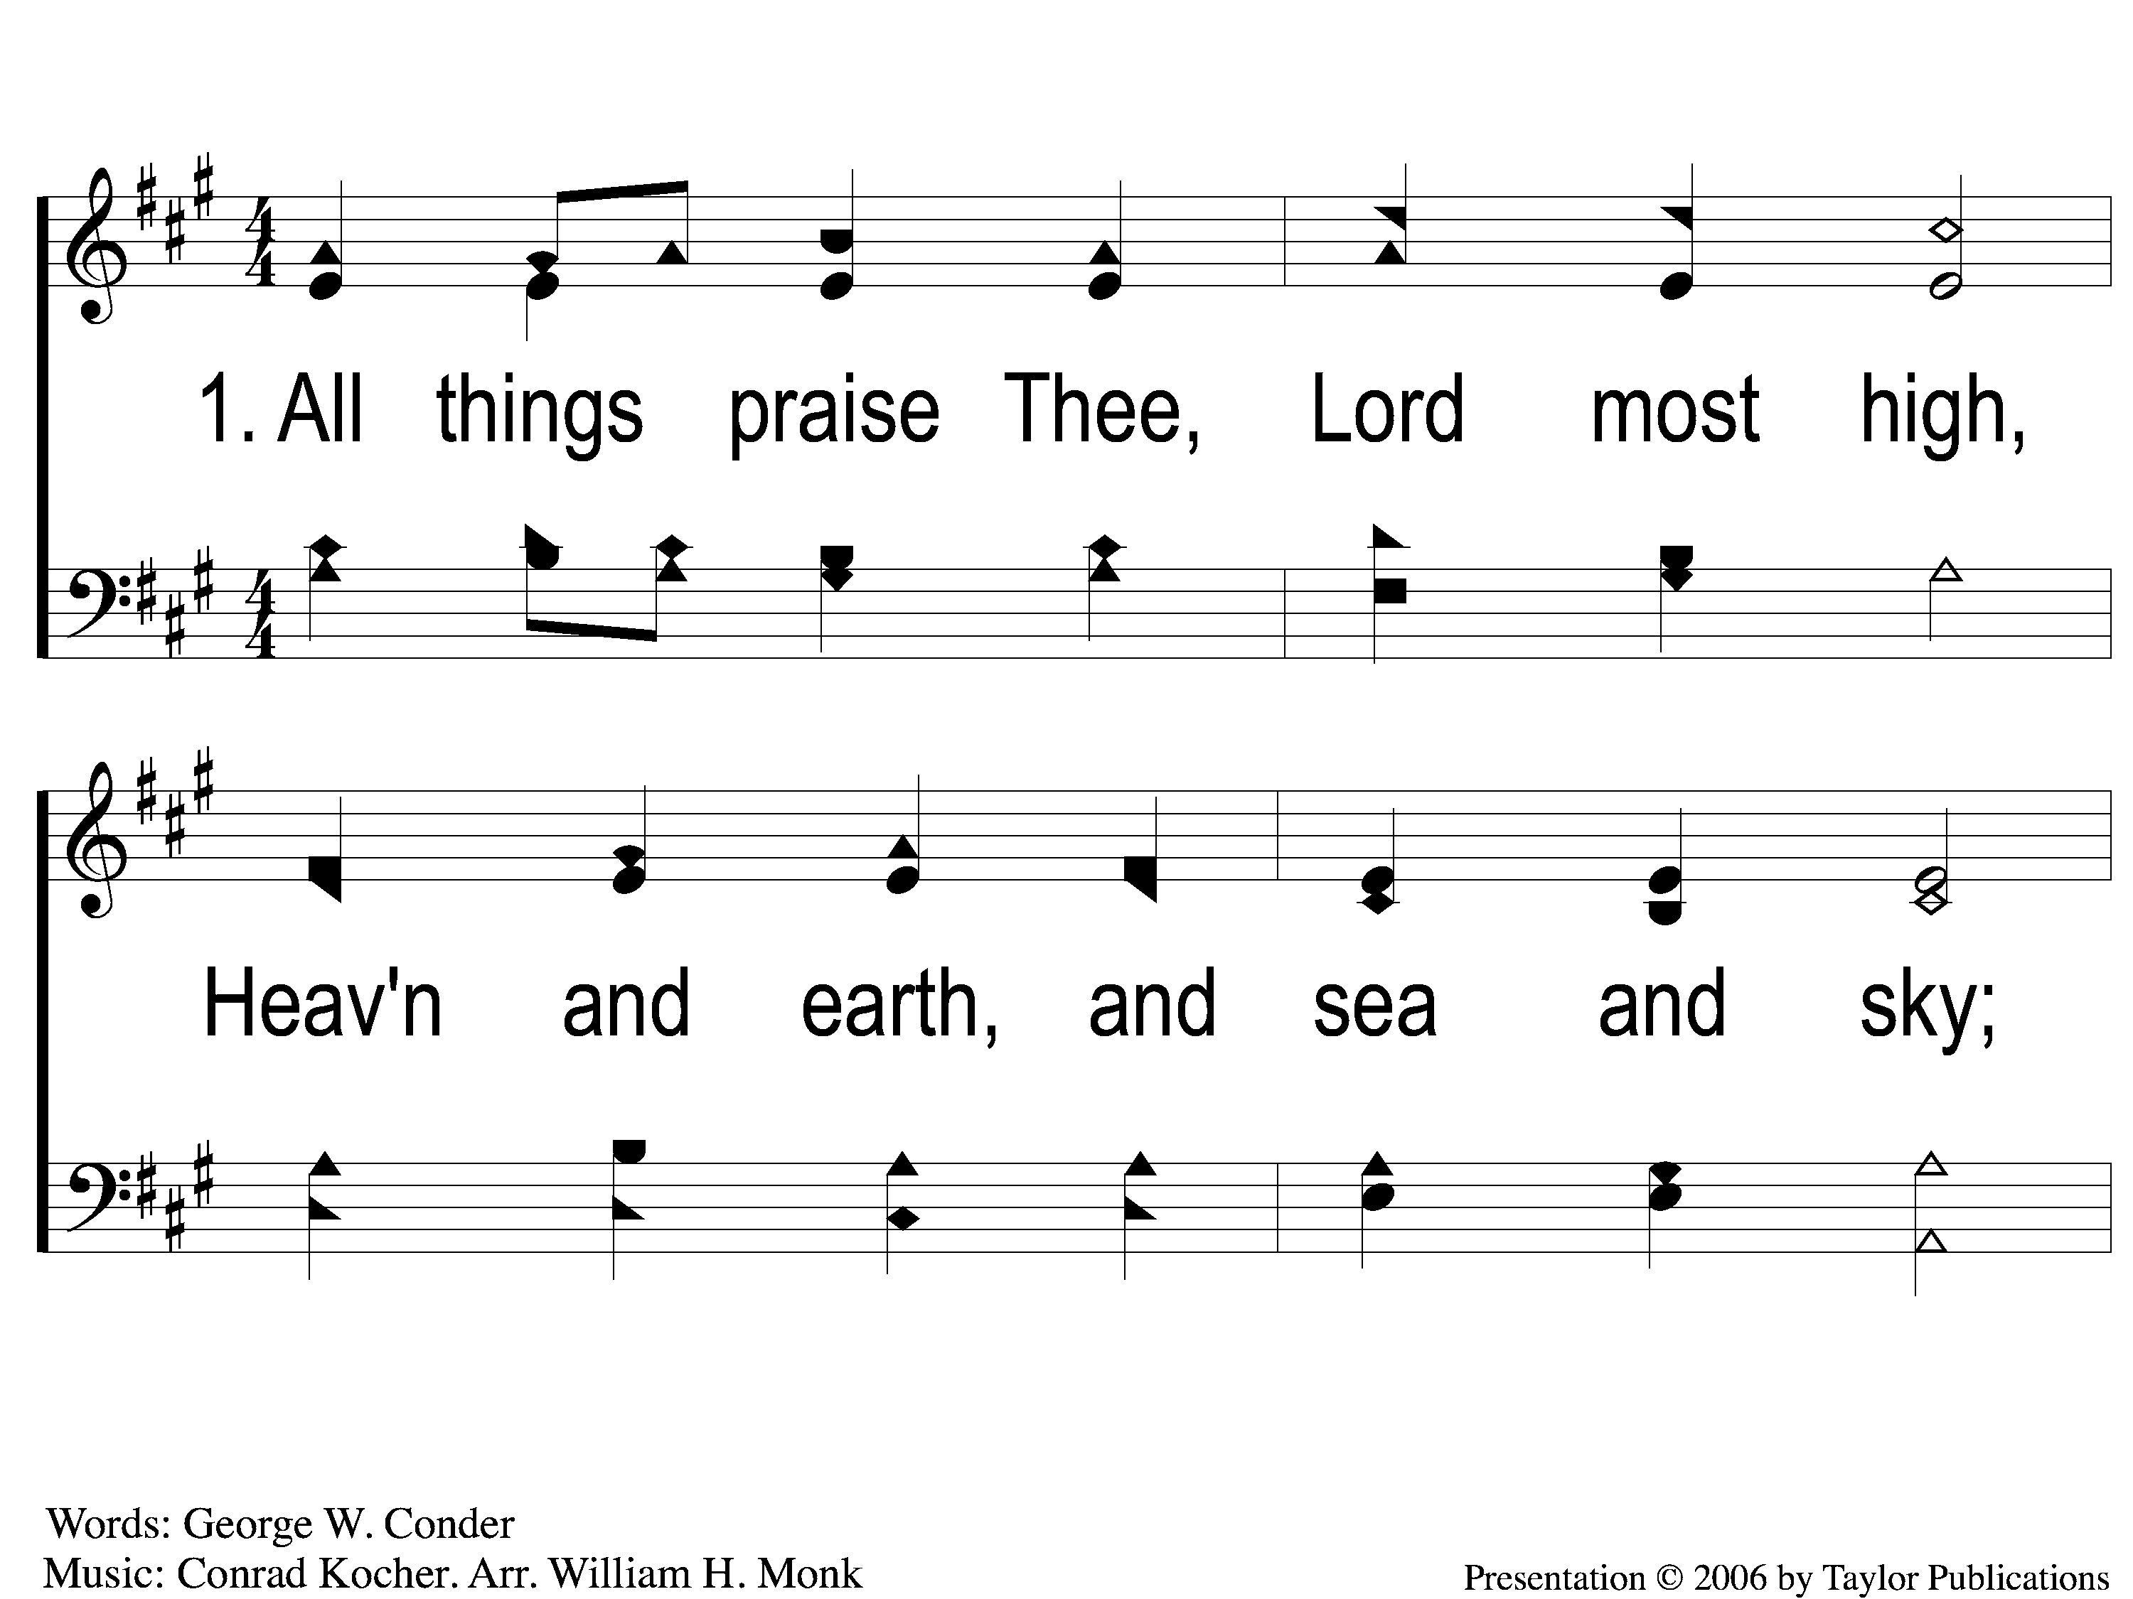
1-1 All Things Praise Thee
All Things Praise Thee
43

Slide 2
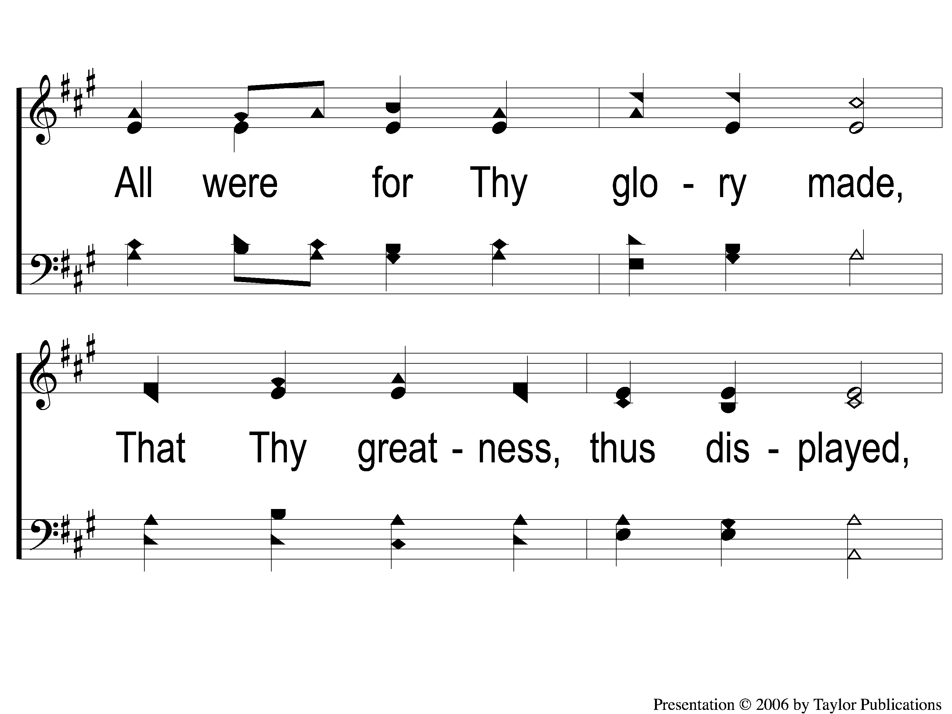
1-2 All Things Praise Thee
All Things Praise Thee
43

Slide 3
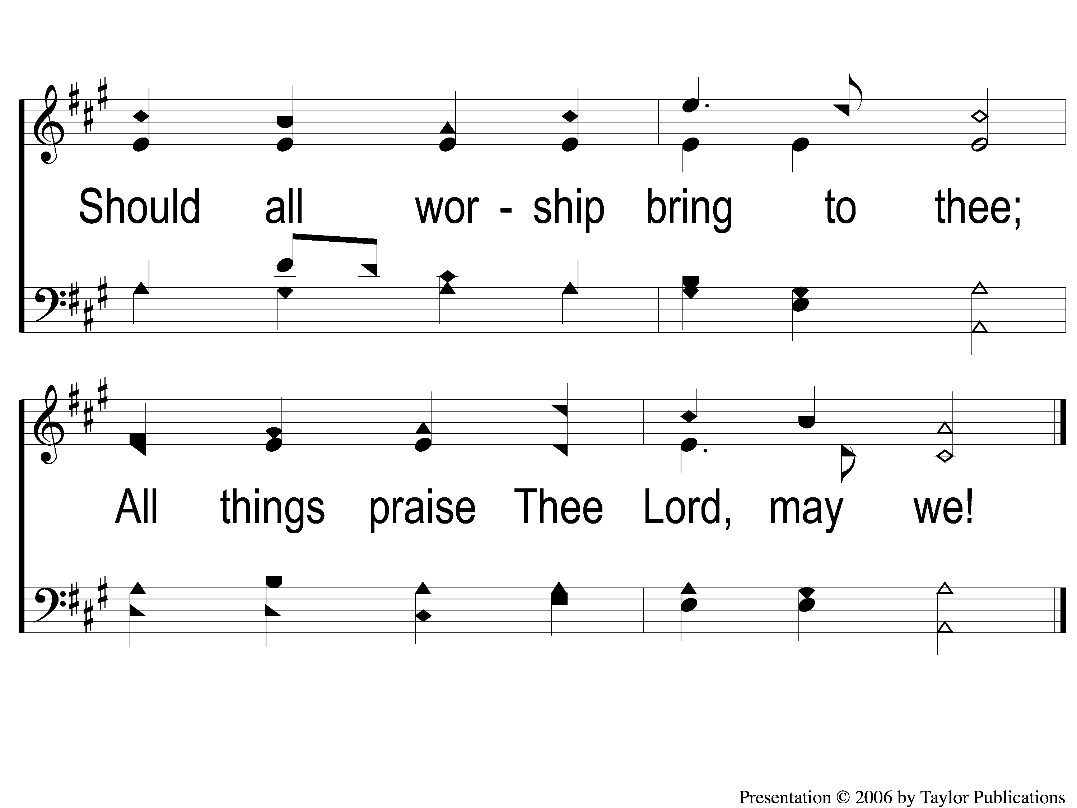
1-3 All Things Praise Thee
All Things Praise Thee
43

Slide 4
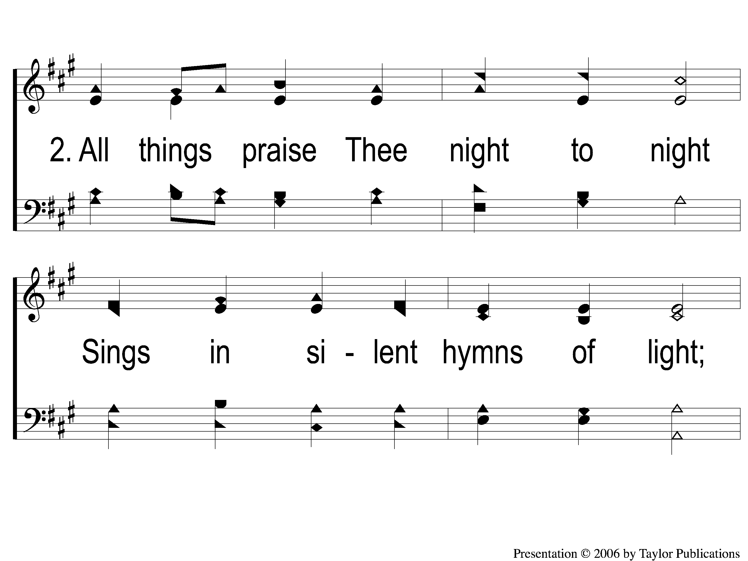
2-1 All Things Praise Thee
All Things Praise Thee
43

Slide 5
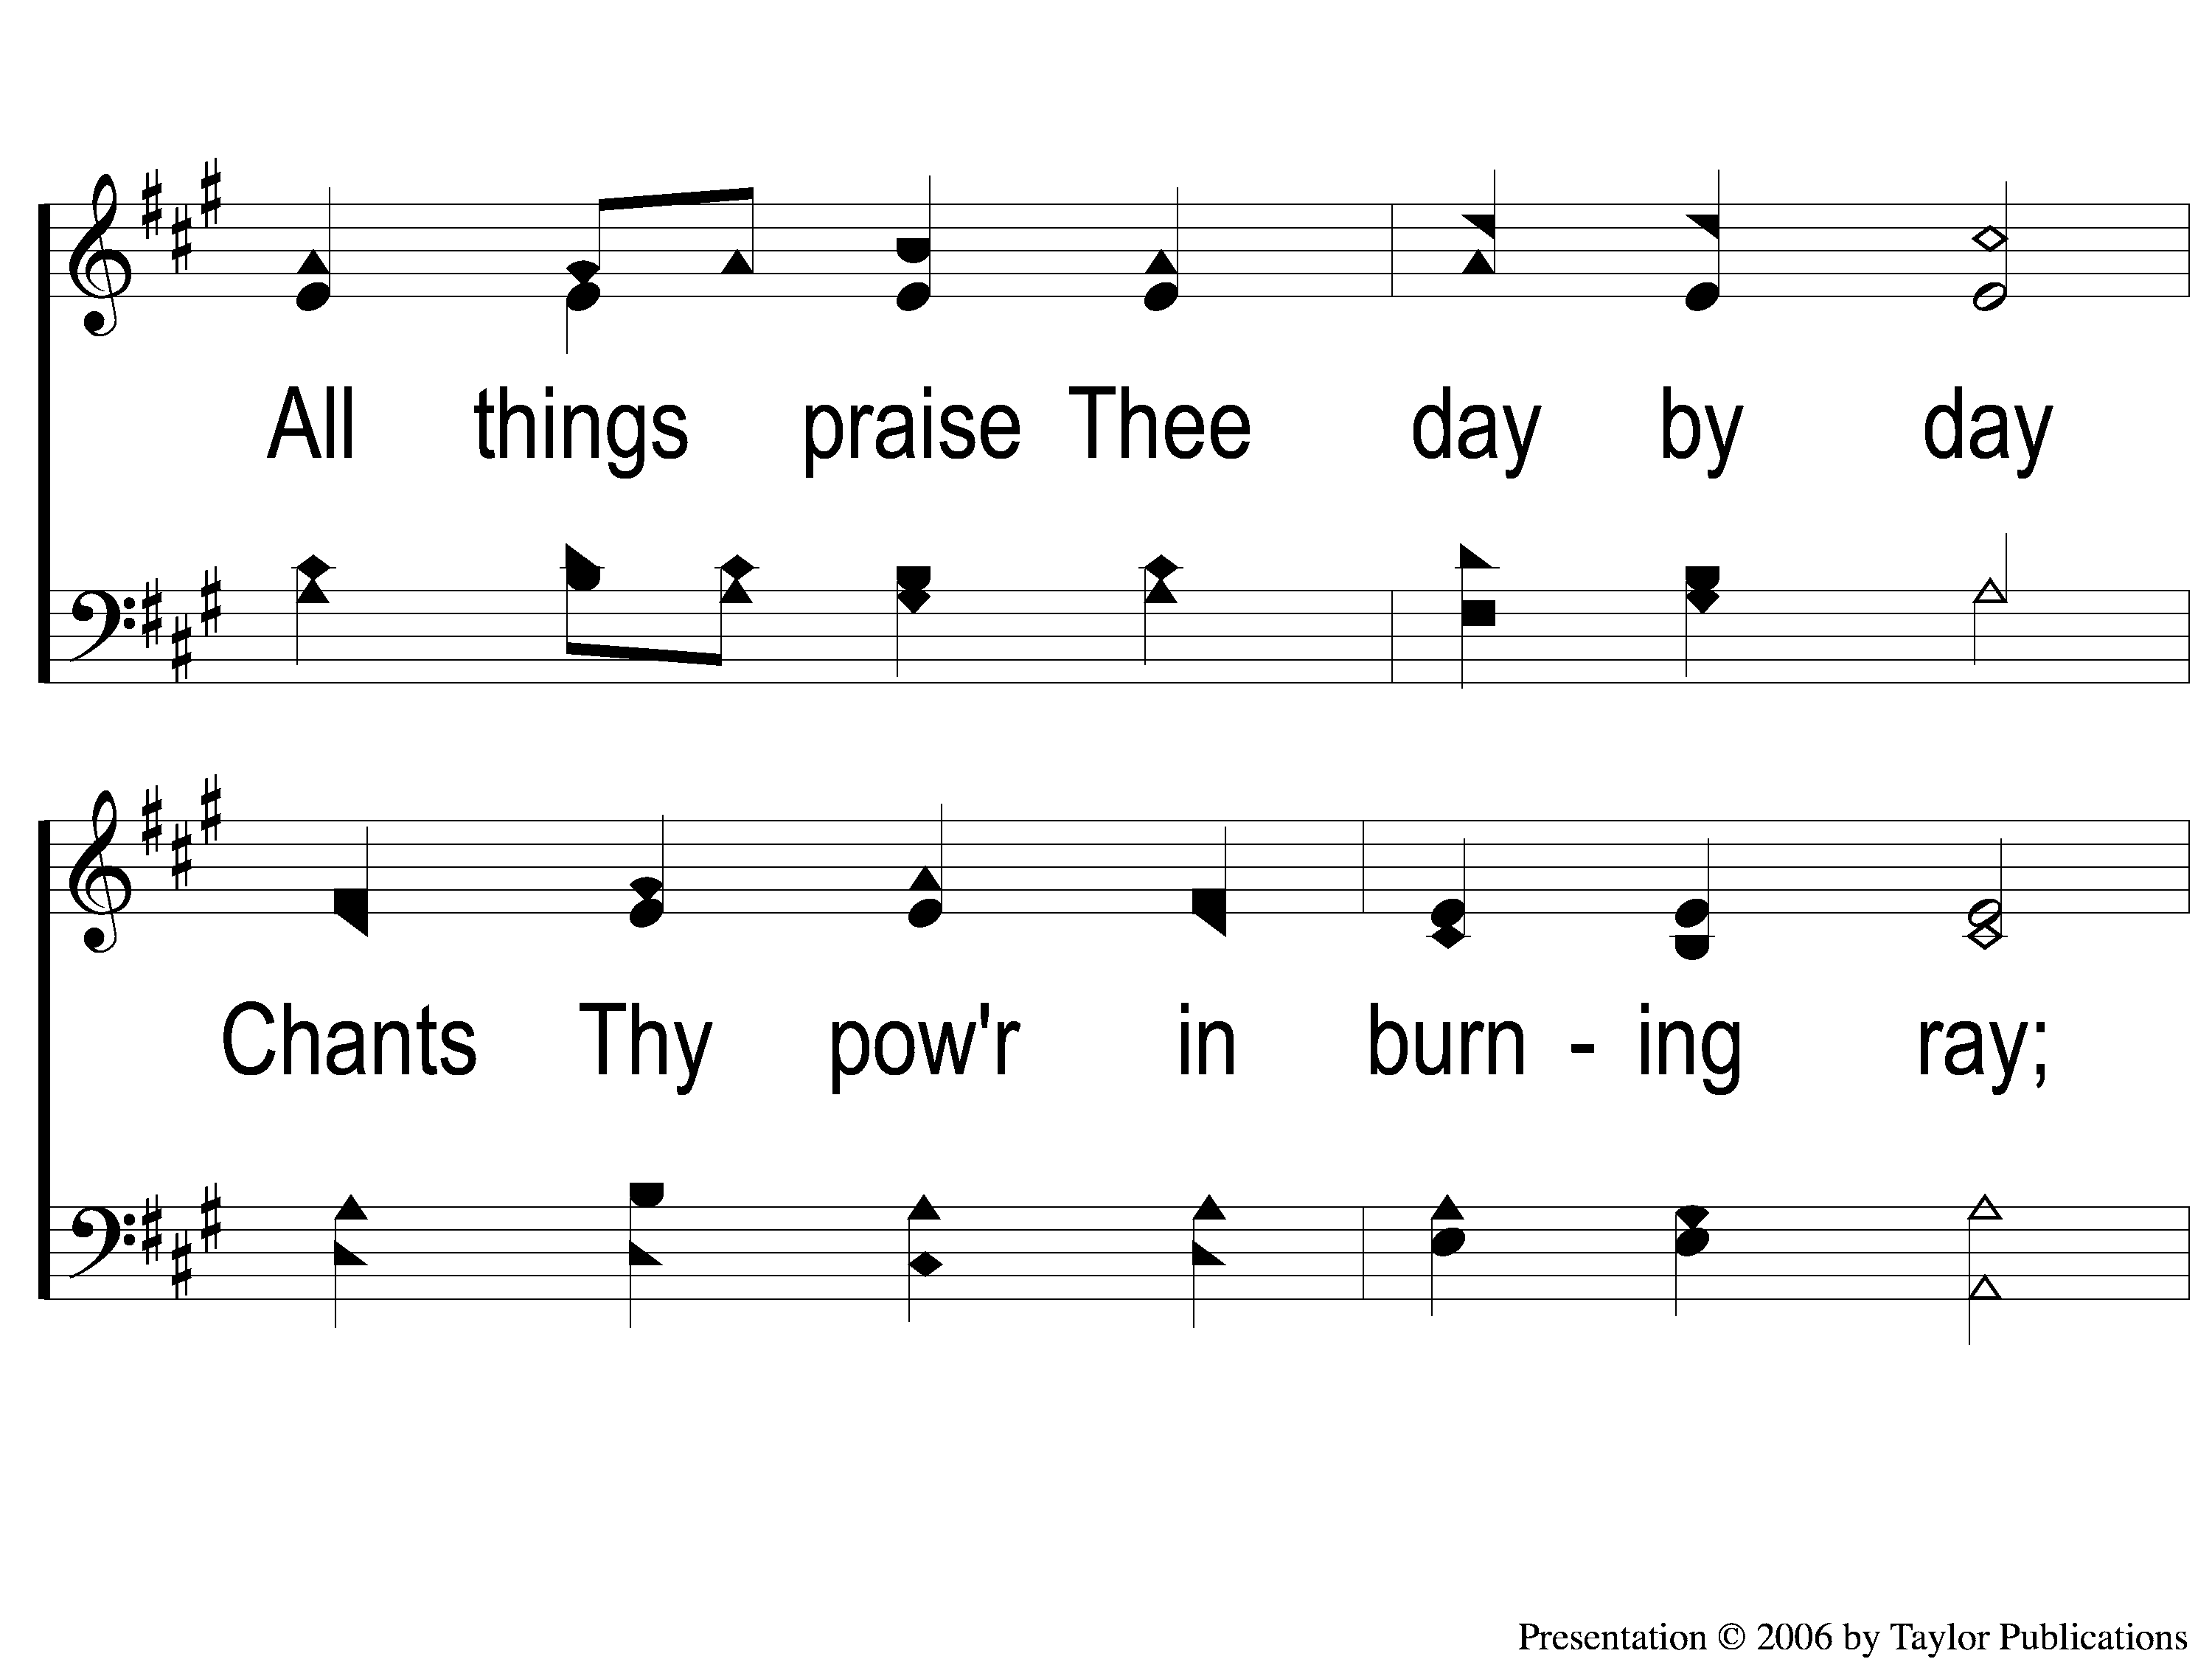
2-2 All Things Praise Thee
All Things Praise Thee
43

Slide 6
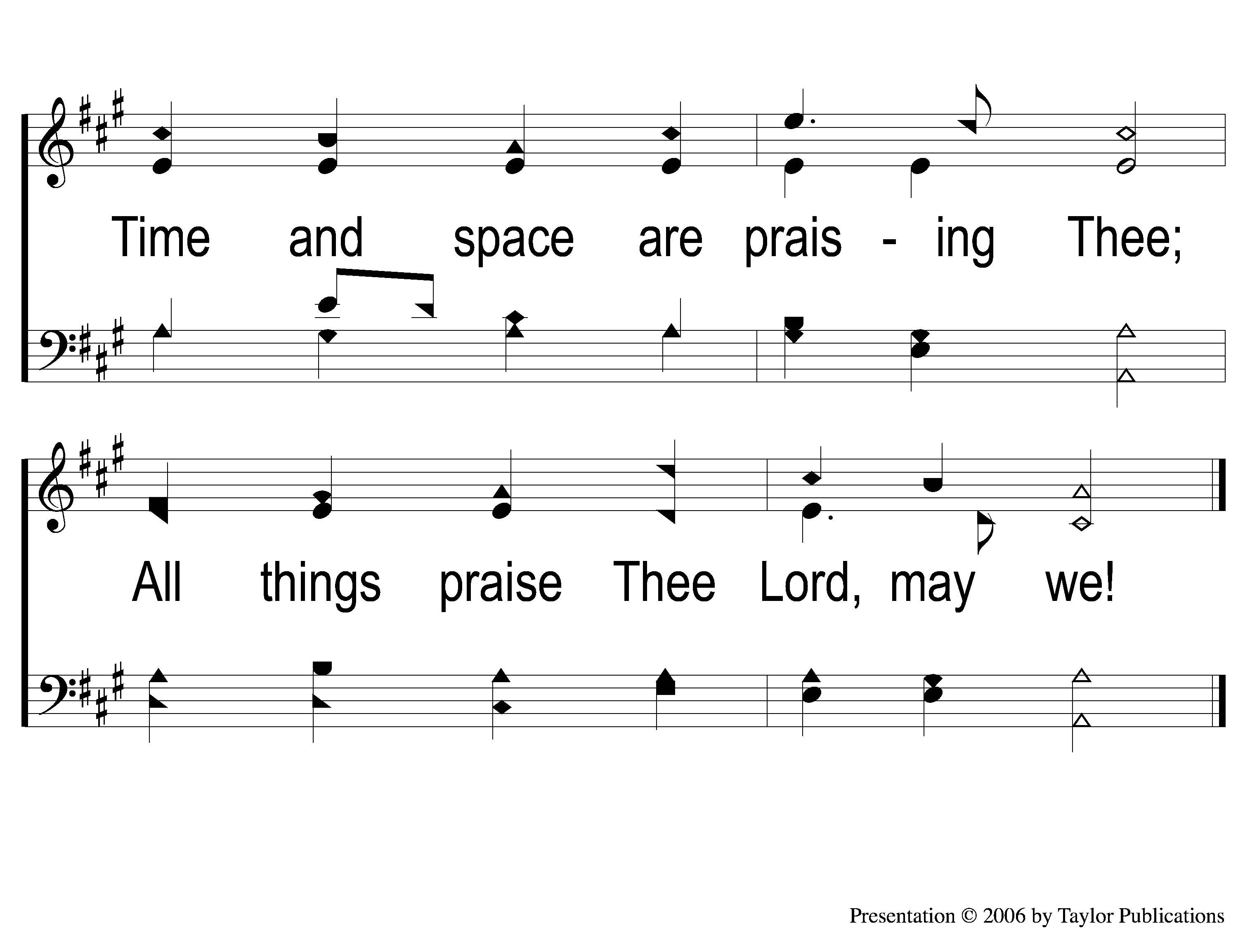
2-3 All Things Praise Thee
All Things Praise Thee
43

Slide 7
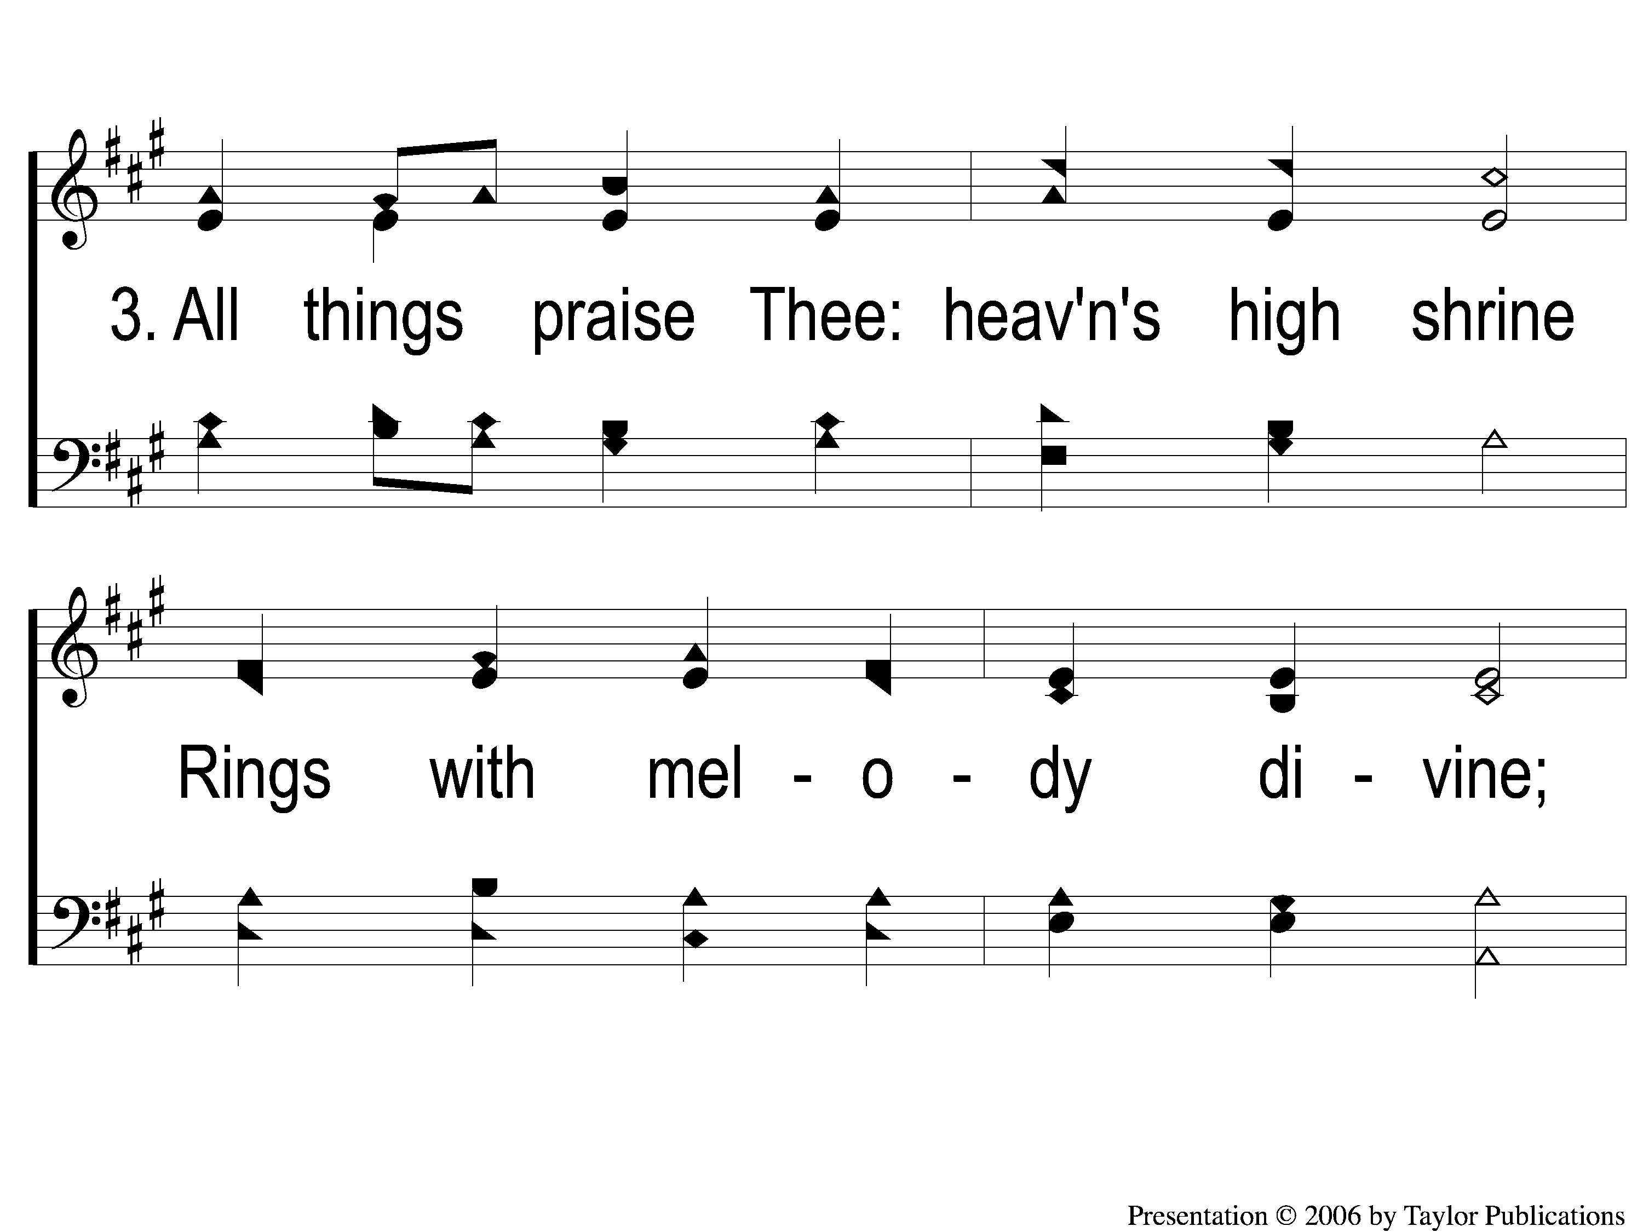
3-1 All Things Praise Thee
All Things Praise Thee
43

Slide 8
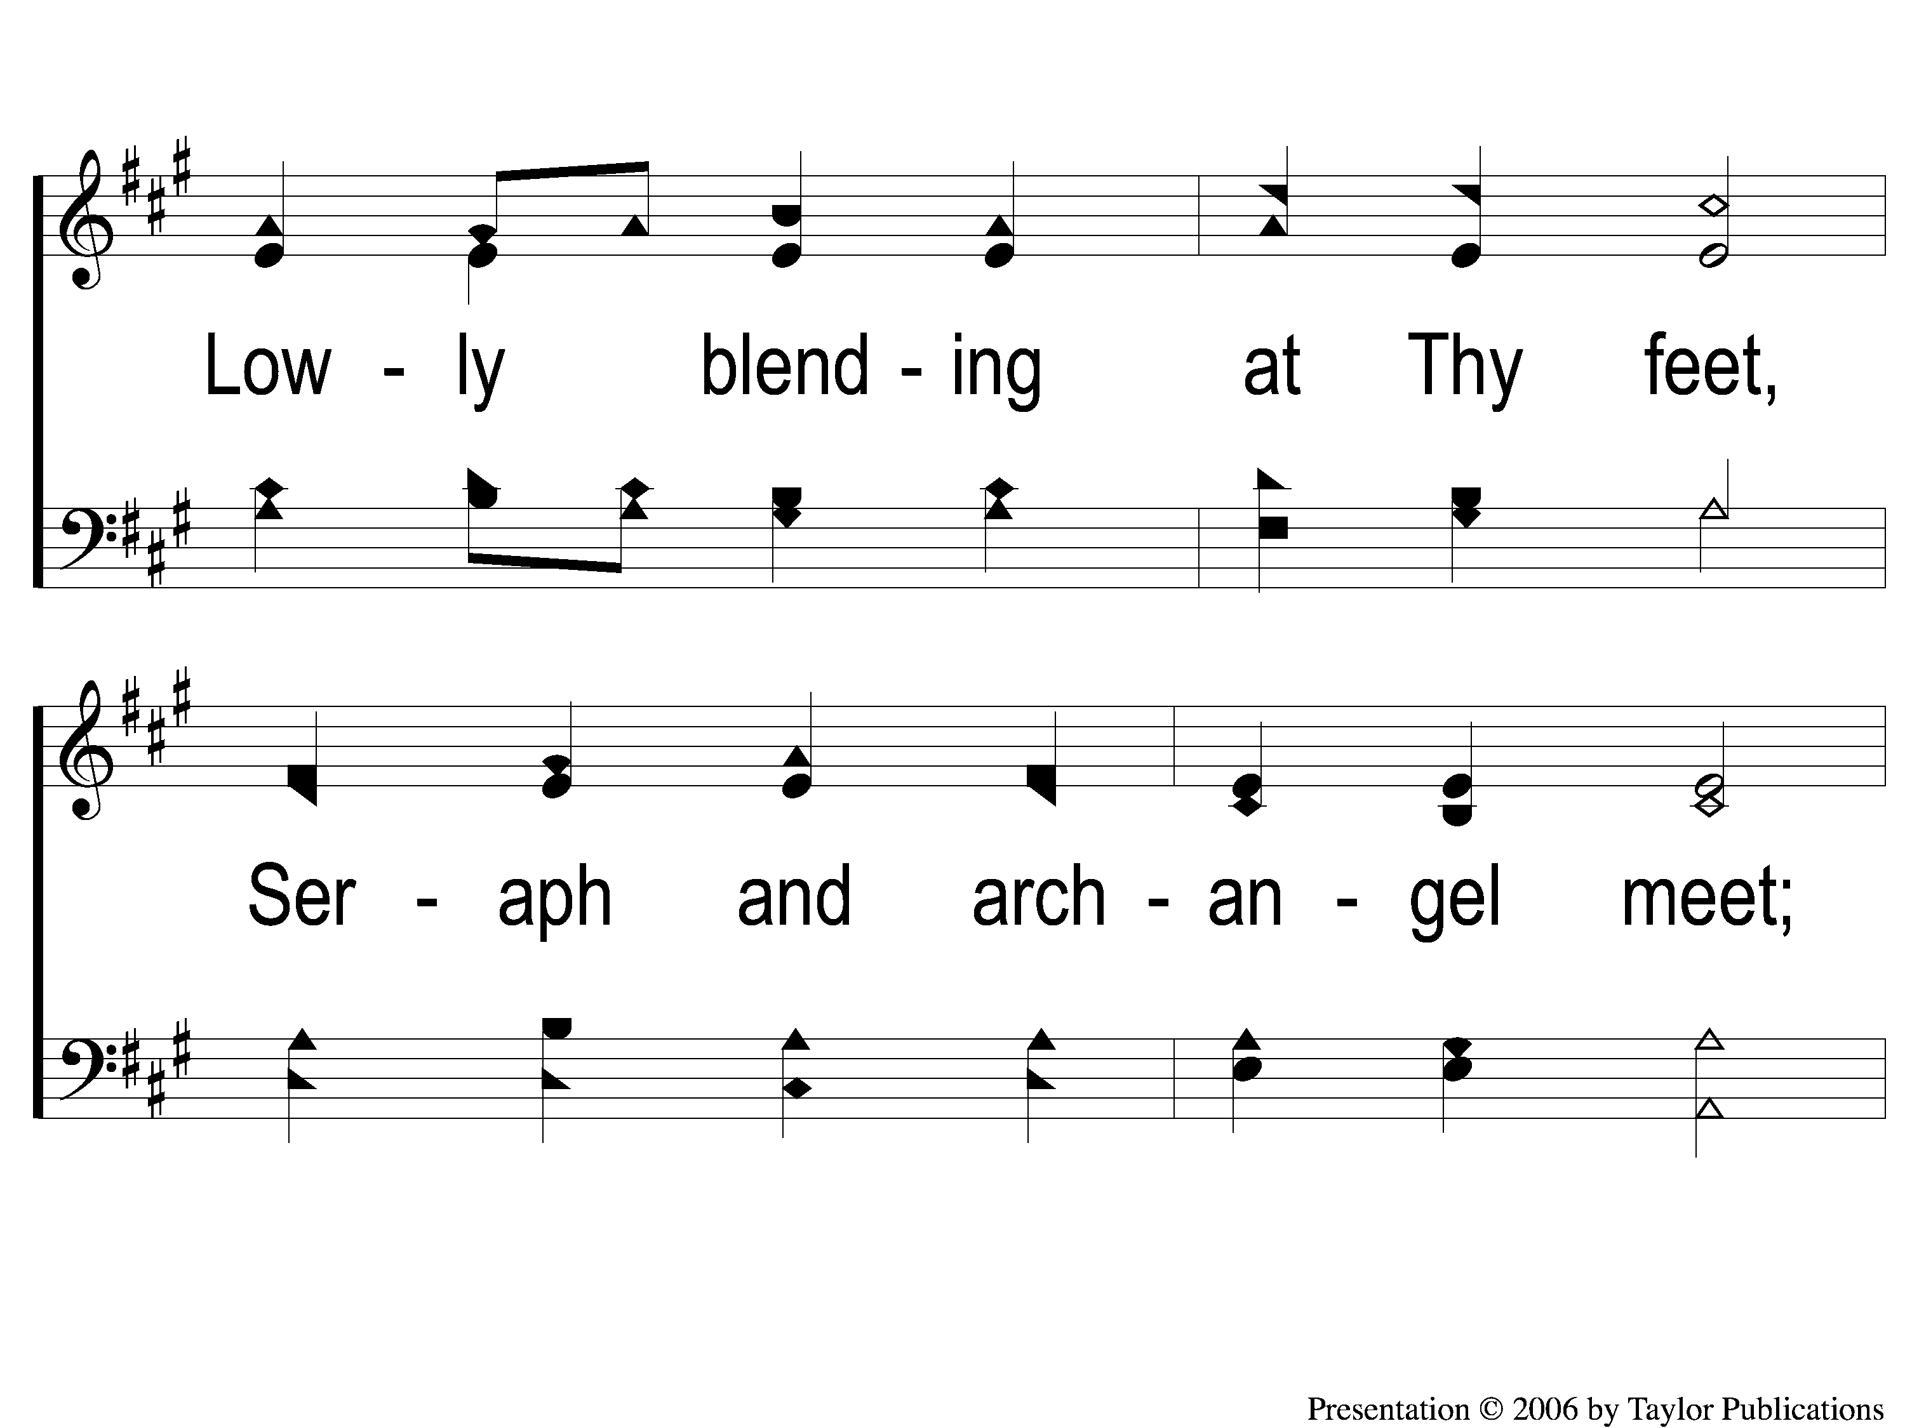
3-2 All Things Praise Thee
All Things Praise Thee
43

Slide 9
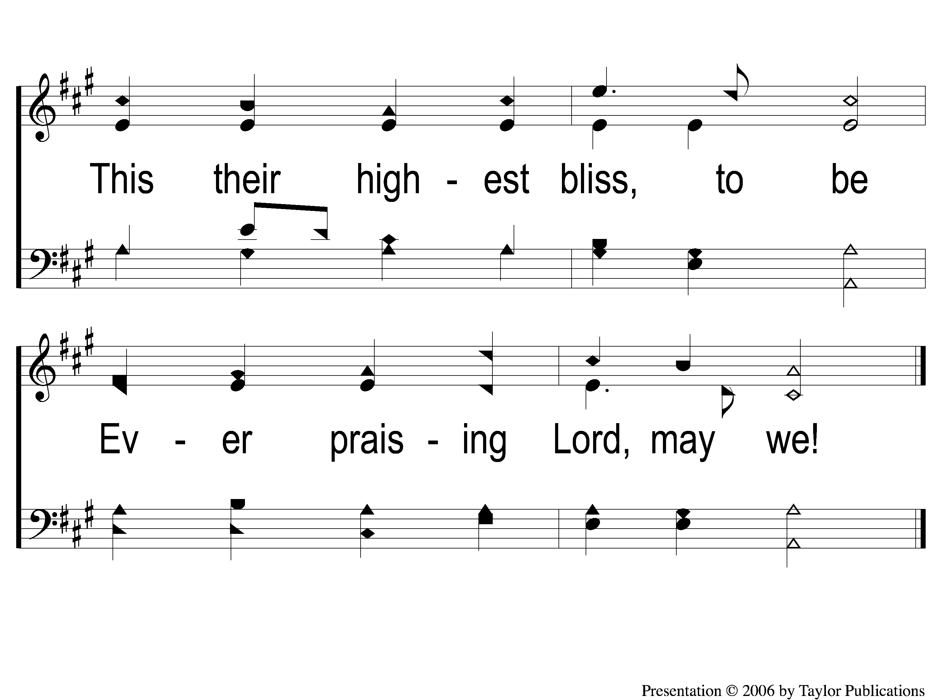
3-3 All Things Praise Thee
All Things Praise Thee
43

